Slide 1
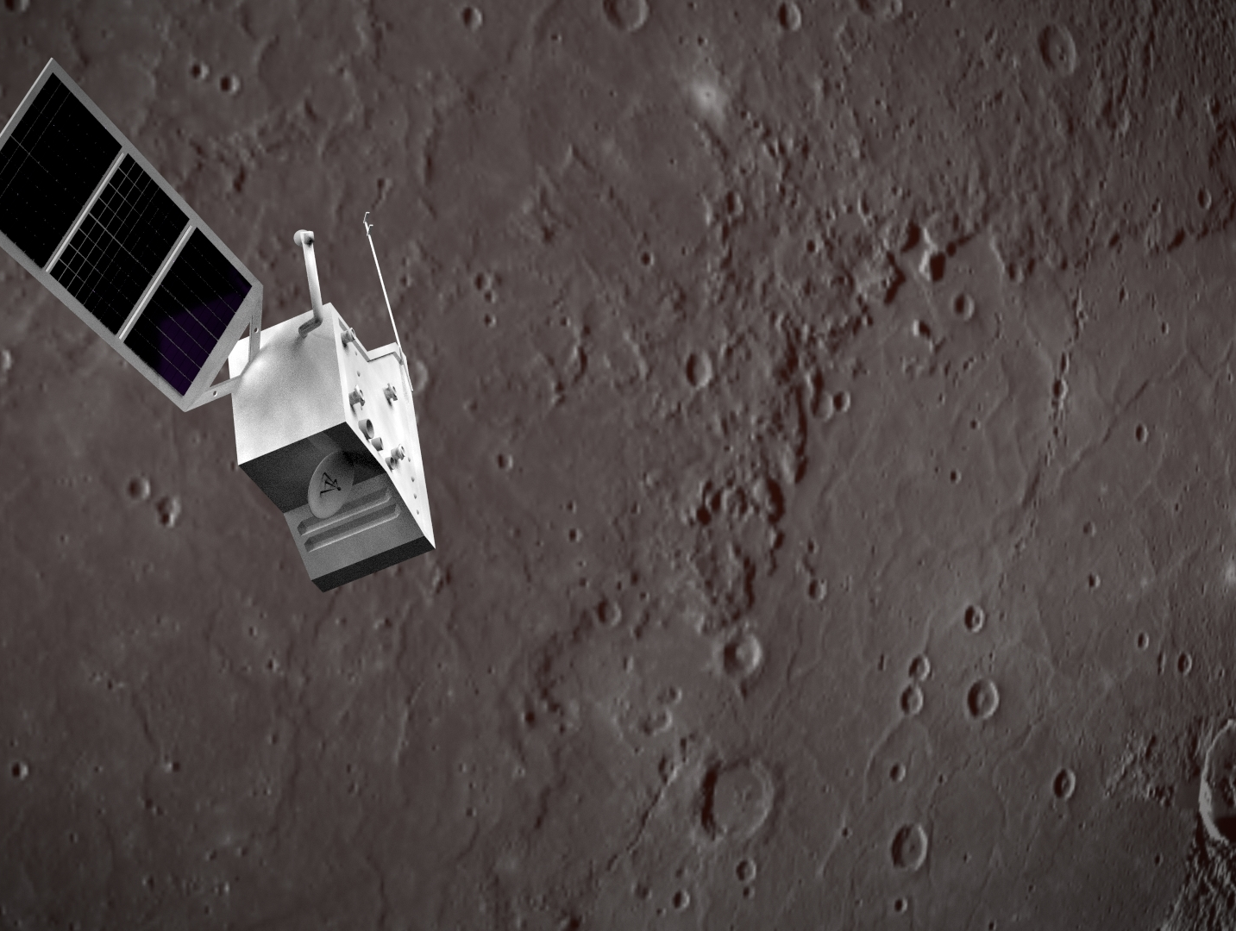
The SOIM STATUS
Emanuele Simioni,
Michele Zusi, Romolo Politi, Livio Agostini, …..
INAF, Osservatorio di Padova, Italy
Notes:
We are always nearer to the first light and it’s better to talk about what will happen at first light

Slide 2
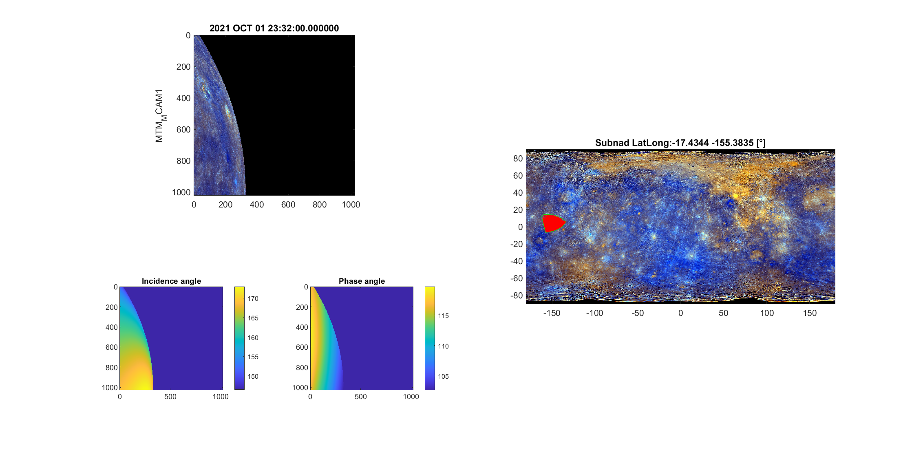
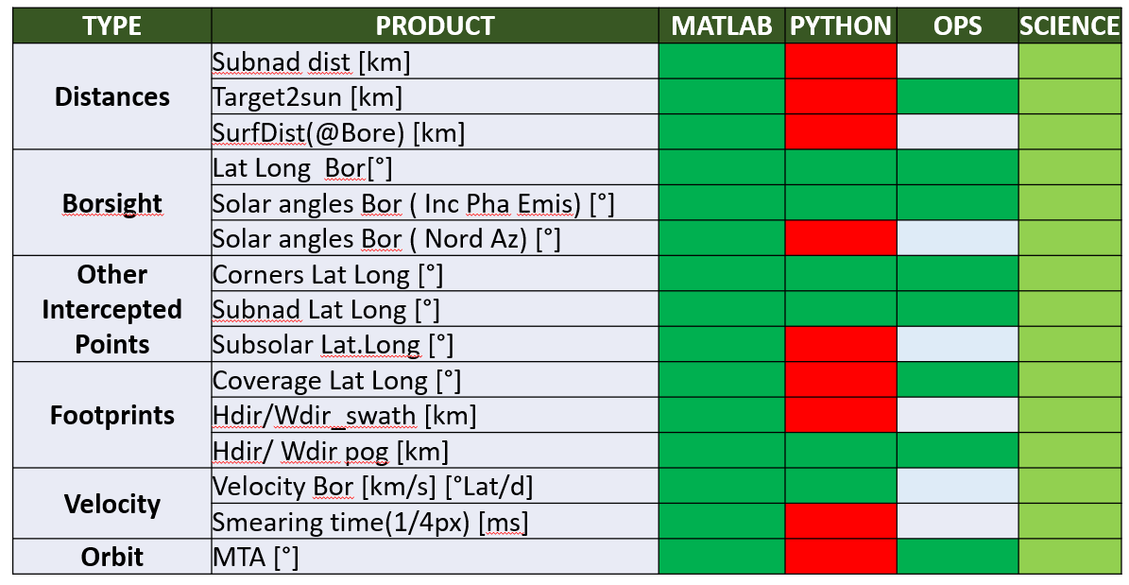
SOIM
MCAM
SIMBIO
Geometric, ARCGIS input report
Rendering (Messenger data)
Shape File
Datasheets
TARGET (HRIC VIHI STC)
Shapefile generation for Science
A lot of parameters
Shapefile generation for
Operations
Few parameters
Corners
Time
Orbit
SwathH
Needed for Science and Time windowing for simulation
2018
GM ( VIHI STC)
Simulation seasons
All parameters
Output excel , csv
First SGS simulations demonstrated a low downlink during Aph2 which could introduce a latency of 140 d if GM will be performed.
Emanuele Simioni

Slide 3
SOIM DIAGRAM
List of Timelines
The process requires 1.9 h considering
INPUT:1 Aphelion
HRIC,
all products including solar angles for each corners (generally not needed )
Tstep 1s (nowadays 10s)
OUTPUT: 1 Datasheet
SK
SOIM
Shape Files
Ops
Shape Files
Science
Datasheets
4 prod
1 prod
1 prod
TARGET ANALISYS
TARGET Planning
VIHI
STRATEGY
STC
STRATEGY
STC
STRATEGY
HRIC
STRATEGY
ZSS & PSS
ZSS & PSS
ZSS & PSS
Emanuele Simioni

Slide 4
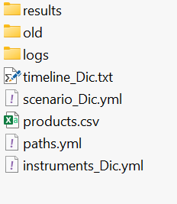
PYTHON VERSION
MY PROJECT
Folder di output
Folder di log
Definizione delle timeline
Missione, orbiter e target
Prodotti richiesti
Percorsi utente
Dizionario strumenti
Simulazione
Sistema
> SOIM paths.yml instrument_Dic.yml scenario_Dic.yml timeline_Dic.txt products
Emanuele Simioni

Slide 5
INPUT DI SISTEMA
Orbiter: 'BEPICOLOMBO MPO'
Target: 'Mercury'
Target Frame: 'IAU_Mercury'
scenario_Dic.yml
instruments_Dic.yml
MPO_SIMBIO-SYS_HRIC_FPAN : -121612
MPO_SIMBIO-SYS_HRIC_F550 : -121611
MPO_SIMBIO-SYS_HRIC_F750 : -121613
MPO_SIMBIO-SYS_HRIC_F880 : -121614
MPO_SIMBIO-SYS_STC-L_P700 : -121625
MPO_SIMBIO-SYS_STC-H_P700 : -121626
MPO_SIMBIO-SYS_STC-L_F920 : -121623
MPO_SIMBIO-SYS_STC-L_F550 : -121624
MPO_SIMBIO-SYS_STC-H_F420 : -121627
MPO_SIMBIO-SYS_STC-H_F750 : -121628
MPO_SIMBIO-SYS_VIHI_FPA : -121630
MTM_MCAM1 : -652950
MTM_MCAM2 : -652960
MTM_MCAM3 : -652970
paths.yml
MICE: 'SIMBIOSYS_OPS_TOOLS\SK_SIMULATOR\MICE\mice64'
SPICE: 'kernels20230918\mk\bc_plan_v411_20230917_001.tm'
Emanuele Simioni

Slide 6
DIAGRAM EXTENDED
CRONTAB
Spice Kernels (MK)
List of Timelines
SAR
SOIM
The bot run on the SERVER:
Check there is a new MetaKernel;
Download all the new kernels;
Run the SOIM - all channels (H SH SL V Science)
Transfer the data to the final destination;
Send a notification
Shape Files
Ops
Shape Files
Science
Datasheets
TARGET ANALISYS
TARGET
Planning
VIHI
STRATEGY
STC
STRATEGY
STC
STRATEGY
HRIC
STRATEGY
ZSS & PSS
ZSS & PSS
ZSS & PSS
Emanuele Simioni

Slide 7
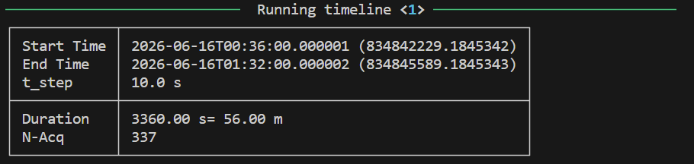
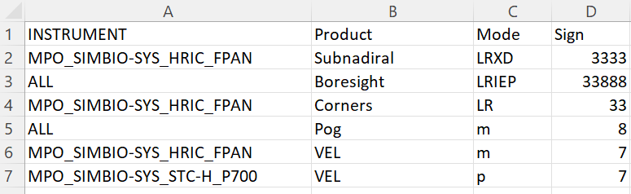
INPUT DI SIMULAZIONE
timeline_Dic.txt
20-Apr-2026 00:00|60|20-Apr-2026 01:01|MPO_SIMBIO-SYS_STC-L_P700 MPO_SIMBIO-SYS_STC-H_P700
20-Apr-2026 00:00|60|20-Apr-2026 01:01|MPO_SIMBIO-SYS_HRIC_FPAN MPO_SIMBIO-SYS_VIHI_FPA
20-Apr-2026 21:50|10|20-Apr-2026 21:52|MTM_MCAM3
Products.csv
NEXT SLIDE
Emanuele Simioni

Slide 8
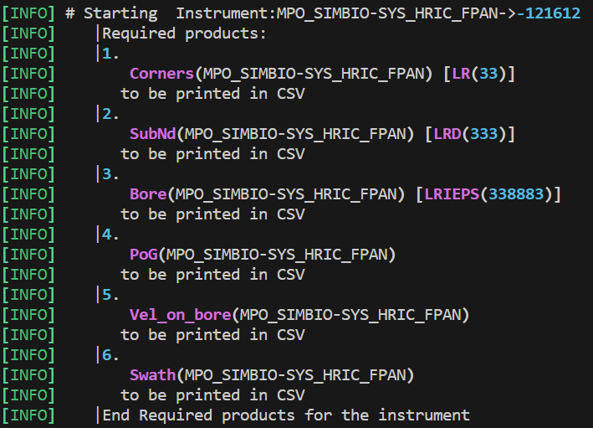
INPUT DI SIMULAZIONE: EXAMPLE OUTPUT TERMINALE
FoV VECTORS
Lat, Long, Ray
SubNad Point
Lat, Long, Distance
Boresight
Lat, Long, Ray
Inc Emis Ph
PixelOnGround
VelOnBoresight
Swath
Emanuele Simioni

Slide 9
INPUT DI SIMULAZIONE: PRODUCTS (FOR NOW)
Product | Definition | Mode | Mode Definition
Subnadiral | Subnadiral point | L | Latitude and longitude [°] of the point
 |  | R | Ray [km] of the point
 |  | X | 3D coordinates xyz [km] of the point
 |  | D | Distance respect the observer.
Boresight | Boresight intersect | L | Latitude and longitude [°] of the point
 |  | R | Ray [km] of the point
 |  | IEP | Incidence, Emission, Phase
 |  | S | Solar Distance from SUN
Corners | FoV Corenrs intersect | L | Latitude and longitude [°] of the point
 |  | R | Ray [km] of the point
 |  | IEP | Incidence, Emission, Phase
PoG | pixel on ground (H/W) | m | pixel on ground in h or w direction in metres
 |  | k | pixel on ground in h or w direction in kilometers
Vel_on_ground | velocity of the boresight | m | velocity of the boresight in m/s
 |  | k | velocity of the boresight in km/s
 |  | p | time to smear 1 pixel in h or w direction
Swath | Swath (H/W) | m | m
 |  | k | km
 |  | d | Degrees
Emanuele Simioni

Slide 10
STATUS
REQUIREMENTs
VERSIONs (Verified)
TYPE | PRODUCT | MATLAB | PYTHON |  | OPS | SCIENCE
Distances | Subnad dist [km] |  |  |  |  | ?
 | Target2sun [km] |  |  |  |  | ?
 | SurfDist(@Bore) [km] |  |  |  |  | ?
Boresight | Lat Long Bor[°]
 | Solar angles Bor ( Inc Ph Emis) [°]
 | Solar angles Bor ( Nord Az) [°]
Other Intercepted Points | 4Corners Lat Long [°]
 | 4Corners Solar Angles (Inc Ph Emis)[°]
 | Subnad Lat Long [°] |  |  |  |  | ?
 | Subsolar Lat.Long [°]
Footprints | Hdir/Wdir swath Lat Long [°]
 | Hdir/Wdir swath [km]
 | Hdir/ Wdir pog [km]
Velocity | Velocity Bor [km/s] |  |  |  |  | ?
 | Velocity Bor [°Lat/s] |  |  |  |  | ?
 | Smearing time(px) [s] |  |  |  |  | ?
Orbit | MTA [°]
TOBEDONE OPS
TOBEDONE SCI
NOT_IMP
NOT_IMPO
Emanuele Simioni

Slide 11
IN FIERI
XLS dei prodotti richiesti (che variano a strumento a strumento) o CSV (l’XLS è limitato)
ShapeFile per HRIC STC, VIHI (sono davvero necessari?)
Valentina per shape file e Canali per CSV definire i prodotti
Mailing list updates?
Emanuele Simioni

